Slide 1

“Location analysis of sales agents in national territory”
Data Analytics Boot Camp Project #1
February 2021

Slide 2
Team 5
Joyce Casiano
Elena Sánchez
Ignacio Morales
Oscar Morales
Eduardo Chacón
Carlos Valverde

Slide 3
Agenda
Background
Analysis Objective
Data Sources
Processing
Analysis
Conclusions
Learned Lessons
Challenges

Slide 4
Background
The dental sector in Mexico, which generates around four billion dollars a year, will grow faster than the national average in 2020, (according to AMIC).
However, the reality in 2020 was different, mainly due to the global pandemic unleashed in the first quarter of that year.
Faced with such situation, companies dedicated to distributing dental materials such as consumables in dental clinics and offices, they have been looking for new ways to optimize their sales resources. For this reason, a company with a national presence has asked the team of analysts to prepare a study that includes an analysis of its sales force.

Slide 5
Analysis Objective
The company has made decisions to adjust its organizational structure in order to generate savings, however, it is concerned to know if the decisions made will greatly affect its operations once the emergency of the pandemics ends, for this reason, they have raised various questions to be answered and which are the starting point of the study and analysis.
Where would be the optimal place to locate sales representatives in the national territory?
Which opportunity areas could result from the analysis?
The company has requested that a study and an analysis be carried out based on data and verifiable facts, they have requested that a study be presented to them with conclusions explaining the methodology used to reach them.

Slide 6
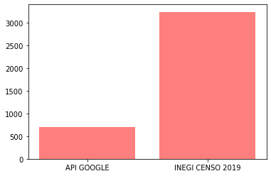
Data Sources
To obtain data on dental offices throughout the national territory, two data sources were explored, the Google Places site and the INEGI site.
After analyzing the two sources, the decision was made to continue the analysis with the INEGI data because it is more reliable, proof of this is the number of economic entities (dental offices) found with each sources and which is shown in the following graph.
Number of dental offices in Guanajuato
Number
INEGI data was also considered for other indicators such as socioeconomic level and population.

Slide 7
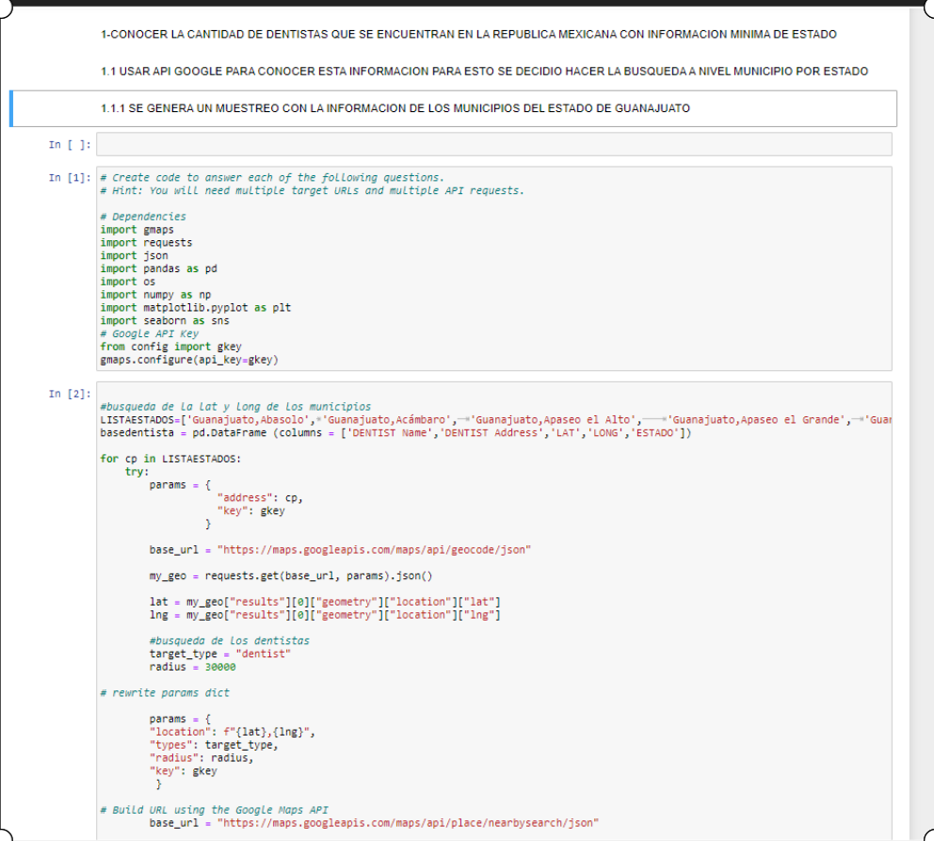
Processing
To process the data, a series of codes were developed to: obtain the data directly from its sources, review the quality of the data, clean it, process it and generate graphics that help us reach and support the conclusions that were generated.
Were used among others:
Google API’s
Google Maps
Jupyter Notebook
Microsoft Excel
Git Hub
Python Pandas

Slide 8
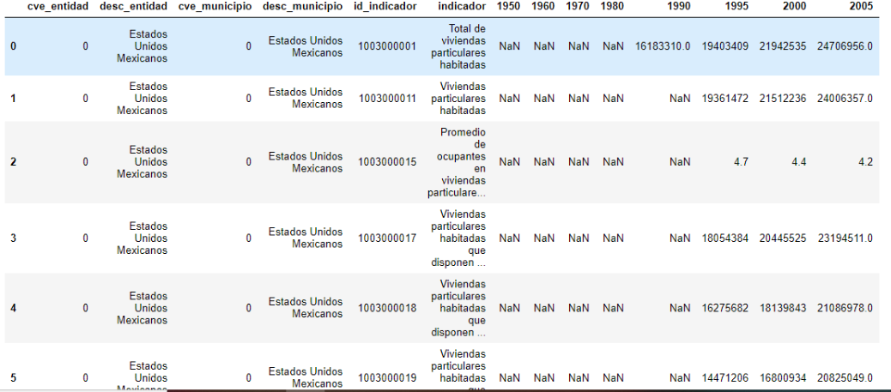
Processing
Pre Clean Data Frame

Slide 9
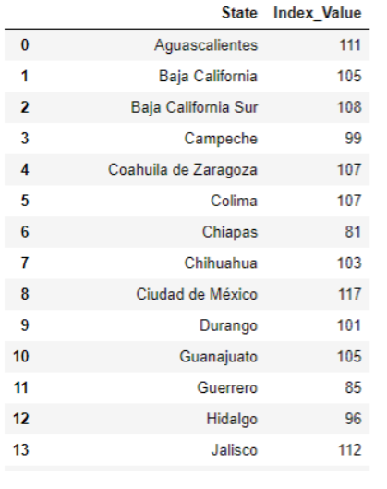
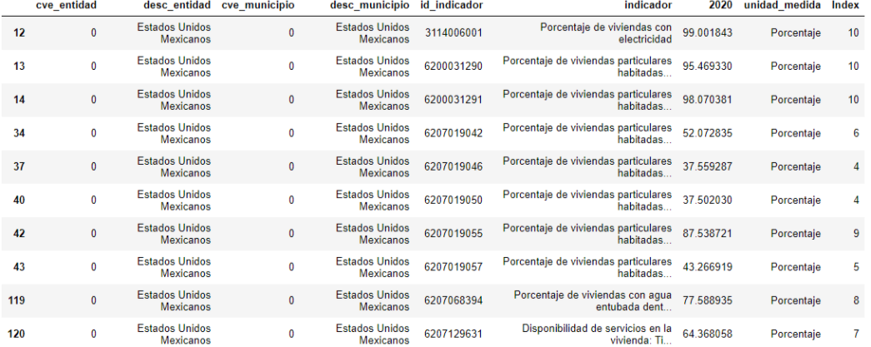
Processing
Clean Data Frame

Slide 10
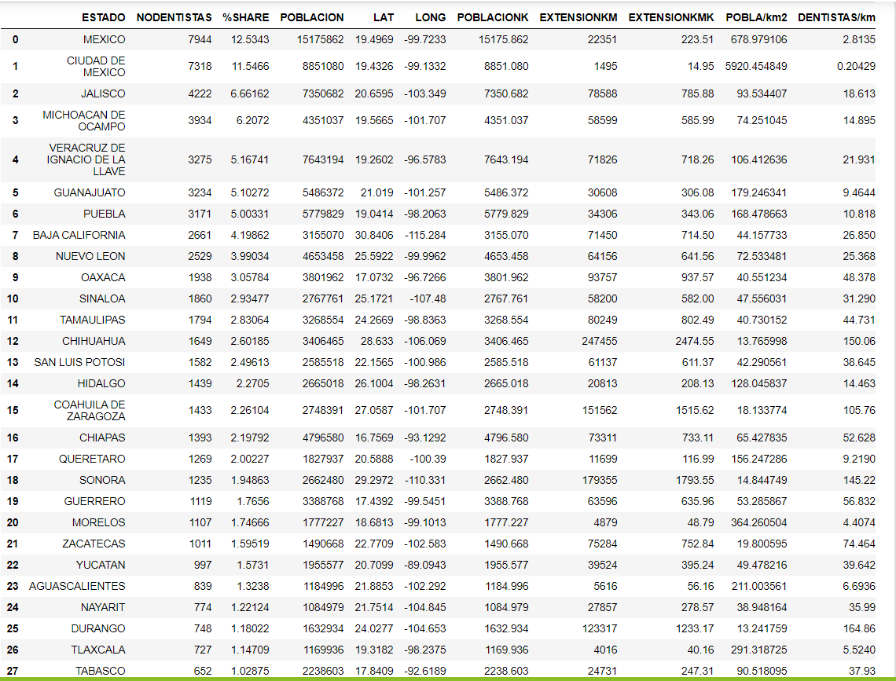
Processing
Data Frames Merged

Slide 11
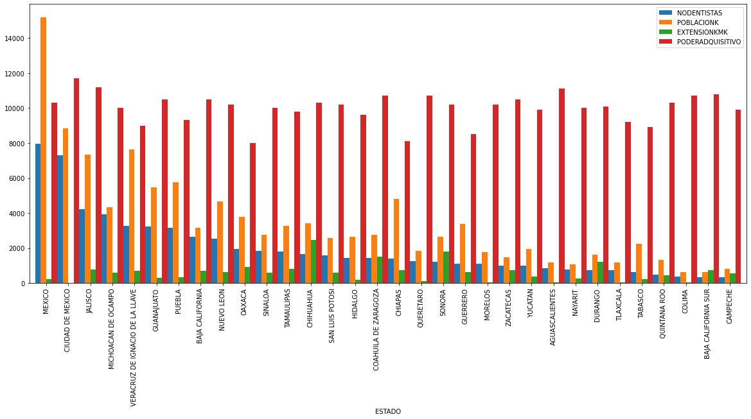
Analysis
Offices number
Population (Thousand)
State size Km2
Socioeconomic index

Slide 12
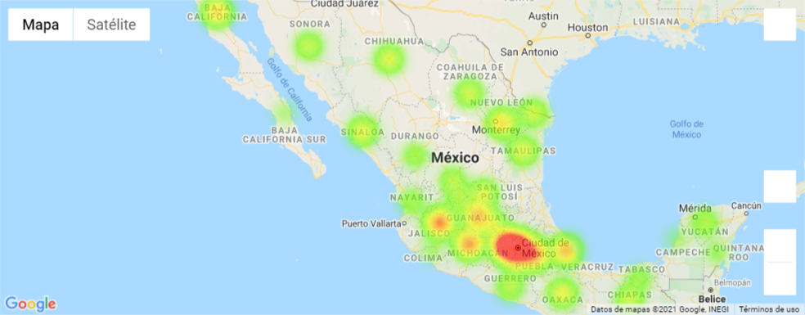
Analysis
Dental offices heat map
The graph shows that there are areas that the dental offices are concentrated in the center of the country and occident.

Slide 13
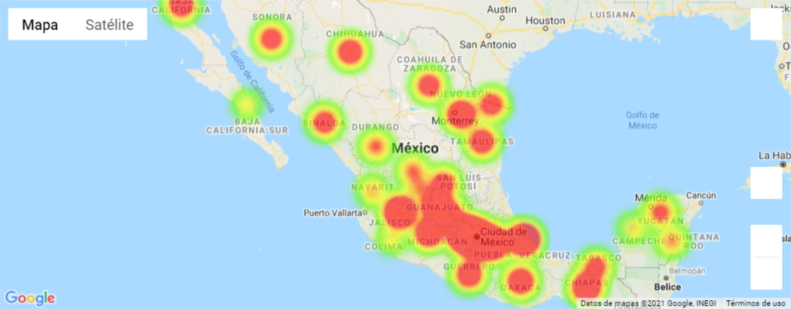
Analysis
Population heat map
Dental offices heat map
The graph shows that there are areas that the population is concentrated in the center of the country and geographically distributed in the north of the country. Important issue for sales representatives locations.

Slide 14
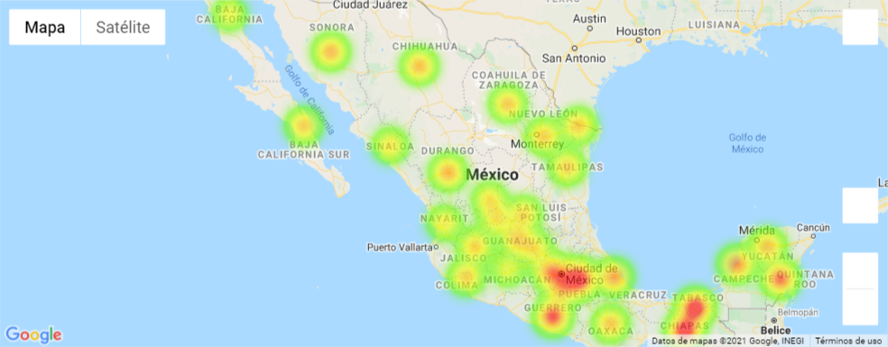
Analysis
Dental offices heat map
Population heat map
Map dentist by Km2
The graph shows that there are areas with more dental offices per Km2 are located in the center and south of the country (Tabasco y Chiapas).

Slide 15
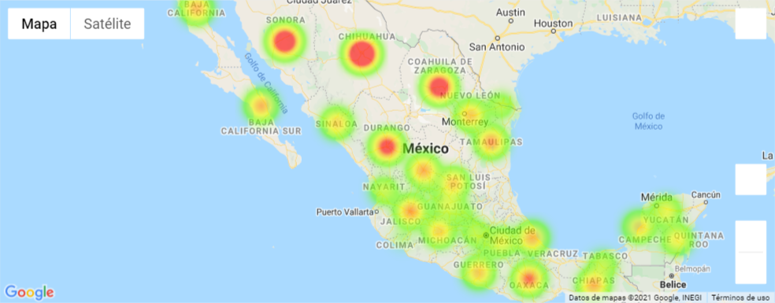
Analysis
Dental offices heat map
Population heat map
Map dentist by Km2
State map by Km2
The graph shows that the biggest states are located in the north of the country, where the cities are more geographically distributed.

Slide 16
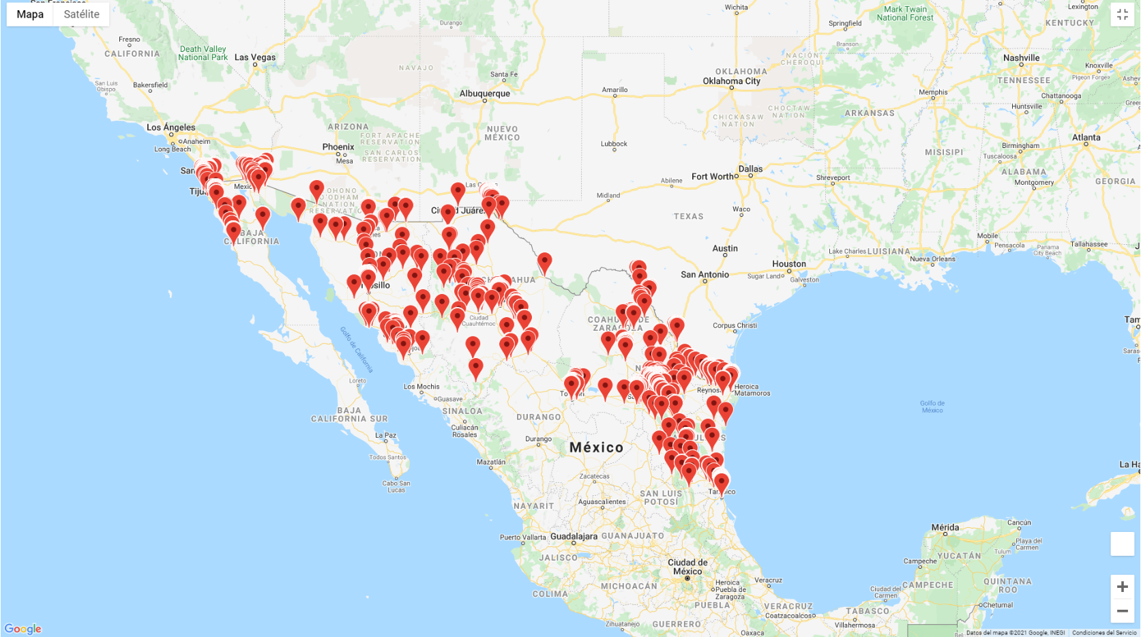
Analysis
The graph shows that the most concentrated

Slide 17
Conclusions

Slide 18
Learned Lessons
Data can be located and obtained in different ways, the easiest and simplest way is always recommended.
It is important to select data from reliable sources, that way the conclusions will also be solid.
Regardless of the data sources, it is highly recommended to review and clean them before starting with the processing and analysis.
Teamwork is essential to achieve the objectives, a better result is achieved and at a better place.

Slide 19
Challenges
The conclusions reached have more to do with a qualitative analysis, based on a review of geographical graphics, however, it would be interesting to accompany it with quantitative optimization models.

